Slide 1

Finding MIMO
Weekly Meeting: Week 5
Kate Bowers, Kristopher Jung, Samuel Spillane

Slide 2
Goals
Model receiver-side CEs to determine the best way to decode received signals
Choose equalization algorithm and parameters
Choose channel estimation technique
Optimize Transmission and Receive Parameters for the best Bit Error Rate, Power Gain, or throughput

Slide 3

Progress
Sophiscating paramatized MIMO function for Cognitive Engine.
Decided to implement two ML techniques for the CE
Genetic Algorithm
Q-Learning Algorithm
Equalizers (only MLSE, LMS + DFE)
Worked on Decision Feedback LMS /RLS/CMA
Interfacing to MATLAB
Trying Manual implementations
Worked on MLSE
Worked on Genetic Algorithm Baseline and Q-Learning Baseline.

Slide 4
MIMO-OFDM Baseline
MIMO Watterson Fading Channel
Random Data Generation
QPSK Modulation
OFDM Modulation
AWGN Fading Channel
Cognitive Engine
Channel Estimation Techniques
Symbol Error Rate Calculation
parameters
Signal Equalization Techniques
Retrieved Data
QPSK Demodulation
OFDM Demodulation

Slide 5
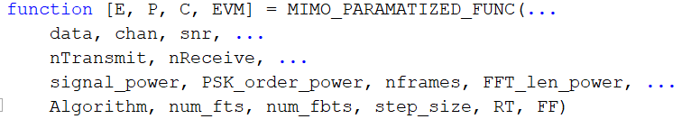
Parameterized MIMO function
We have 13 possible variables that can be tuned simultaneously to optimize 4 possible values. However, there was some occasions where the function crashed when we tried to tune them without sophisticated constraints.

Slide 6
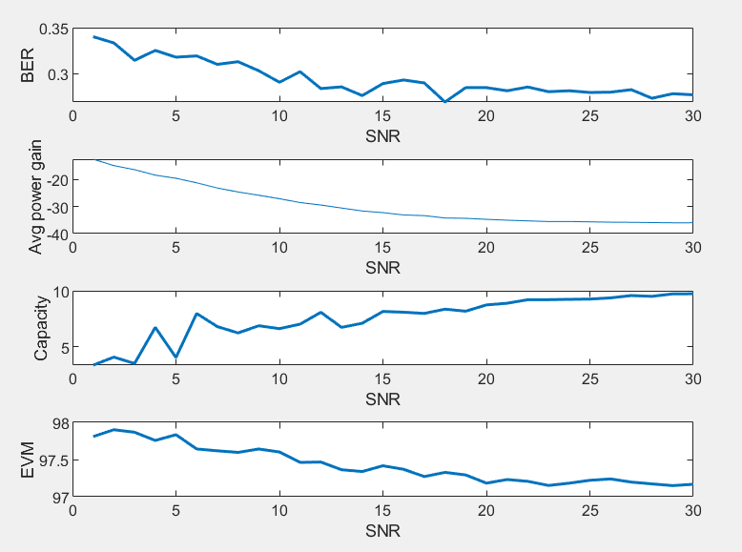
Parameterized MIMO function

Slide 7
Genetic Algorithm for MIMO
Initial implementation achieved by using Genetic Algorithm Package from Matlab
Current Variables
SNR
Equalizer algorithm choice
Step size
Number of forward taps
Number of feedback taps
Optimizing (Minimizing) BER by Epsilon Greedy policy

Slide 8
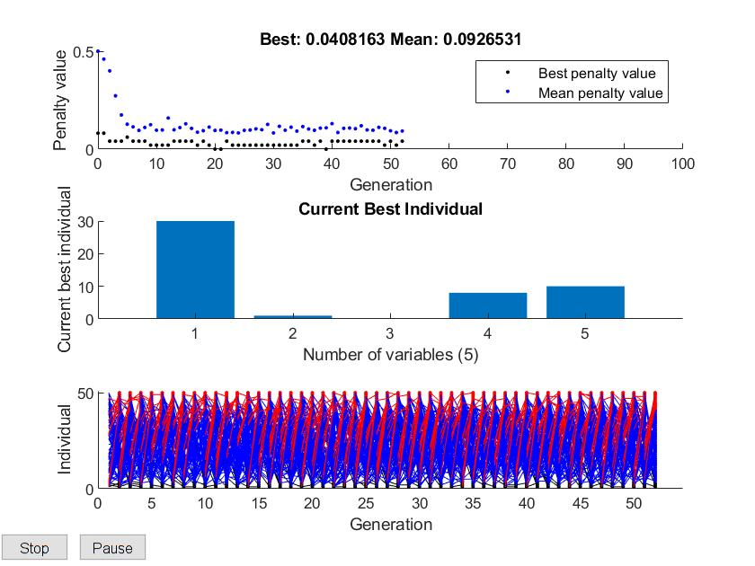
Baseline Genetic Algorithm Simulation
BER
Num_ fts
Num_ fbts
snr
Step size
algorithm

Slide 9
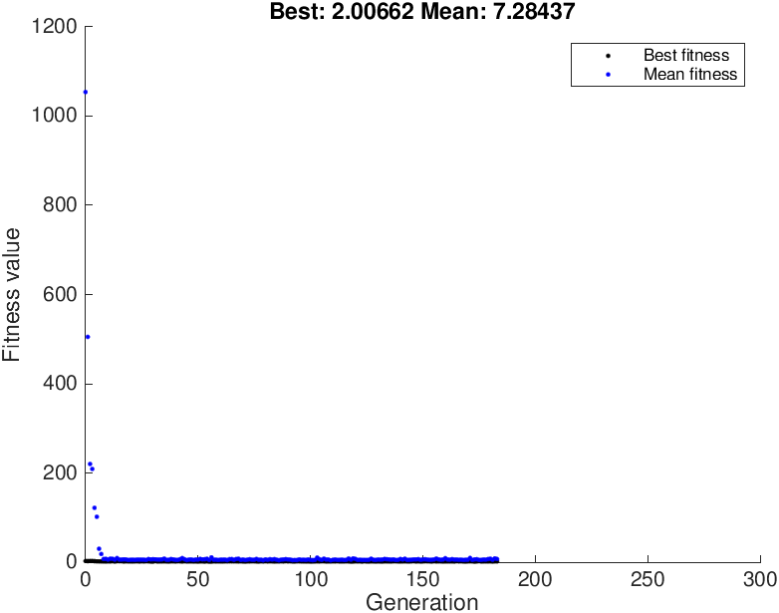
First results from the GA given a very basic MIMO problem

Slide 10
Challenges
Lack of documentation about Q Learning in Matlab
CE implementation issues has made it difficult to settle on effective parameters
Need sophisticated constraints among parameters to make our parameterized function complete error-free.

Slide 11
Roadmap
Week 5 - 6
Working on Q Learning Algorithm in Matlab
Sophisticating Genetic Algorithm engine baseline
Having handwritten implementation of channel estimation and equalization algorithms such as MLSEE
Weeks 7
Work on producing data and derive novel and meaningful conclusion
Misc. issues
Optimization
Week 8-10
Other tasks
paper writing

Slide 12
Questions?

